Slide 1
Unicorn Companies
Emmanuel Olowohunwa
July 2, 2023

Slide 2
Agenda
01. Introduction
02. Problem Statement
03. Dataset and Features
04. Insights Generated
05. Recommendation

Slide 3

Introduction
Unicorn companies are private startups valued at over $1 billion, and they represent some of the most exciting and innovative firms in the business world today. By studying these companies, we can gain insights into what it takes to achieve high growth potential, build a diversified investment portfolio, and prioritize experienced leadership teams.
In this project, we'll be using Python to analyze data on unicorn companies from around the world. We'll explore trends in their funding, revenue, and valuation, and we'll use machine learning algorithms to identify key factors that contribute to their success.

Slide 4
Problem Statement
In order to proffer solution to the problems below I will Explore every features in the dataset to come up with actionable observations and overall recommendations which will be of benefit to the Unicorn Companies; These problems include;
Which unicorn companies have had the biggest return on investment?
How long does it usually take for a company to become a unicorn? Has it always been this way?
Which countries have the most unicorns? Are there any cities that appear to be industry hubs?
Which investors have funded the most unicorns?

Slide 5
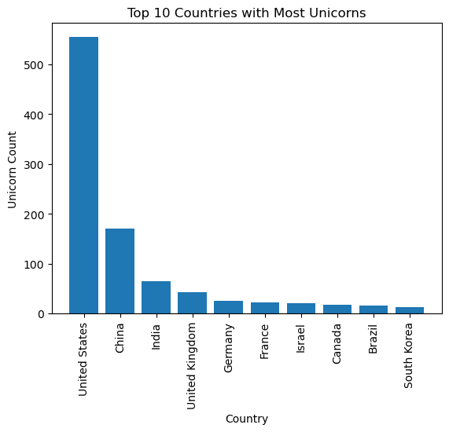
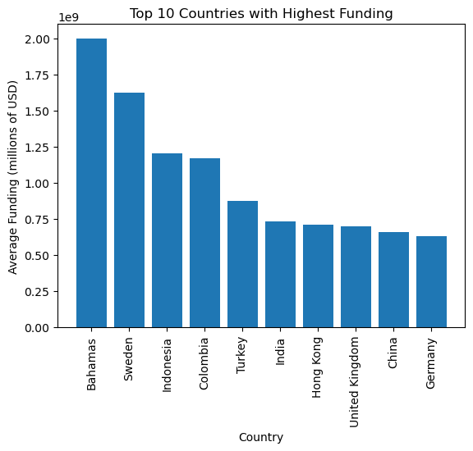
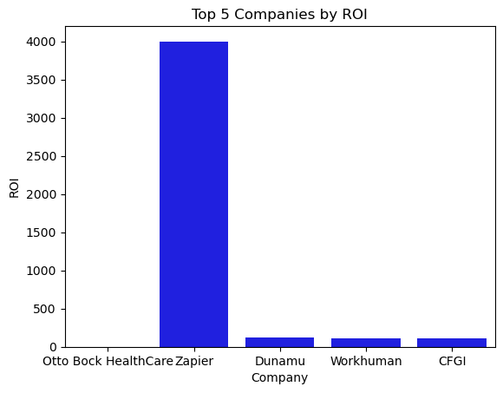
Insight

Slide 6
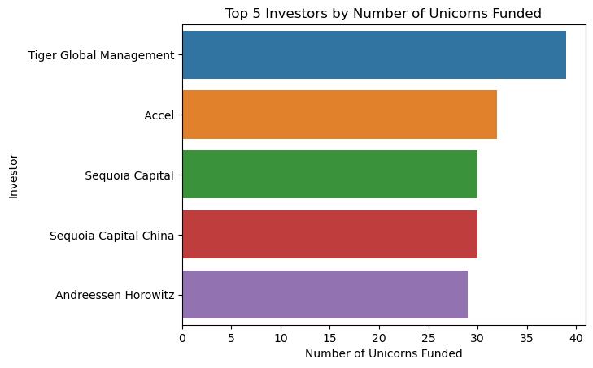
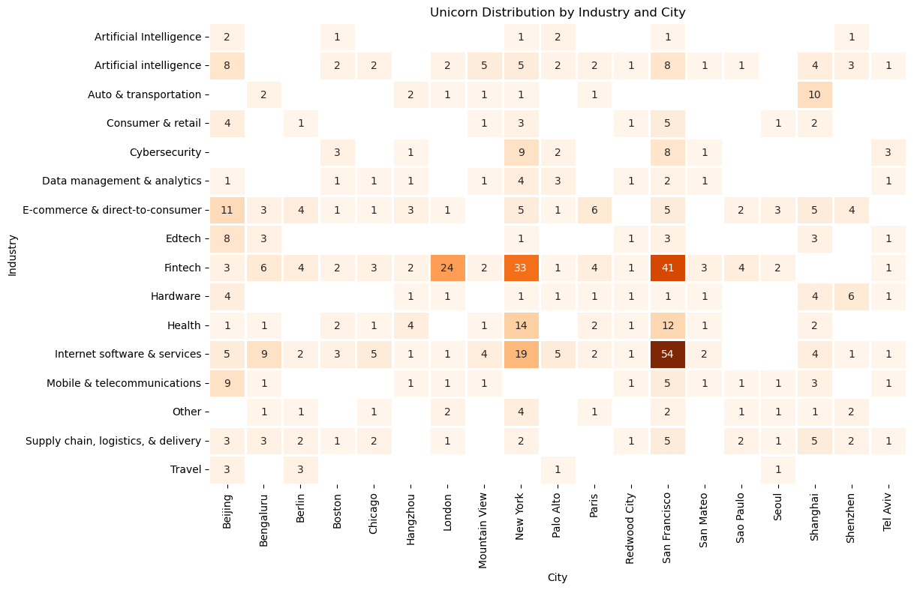
Insight

Slide 7
Findings
The United States has the highest average funding for startups, followed by China and the United Kingdom.
The top 10 countries with the highest funding for startups are dominated by North American and Asian countries.
The distribution of funding for startups is heavily skewed to the right, indicating that most startups receive relatively low amounts of funding.
There is a positive relationship between funding and valuation for startups, indicating that startups with higher funding tend to have higher valuations.
The distribution of unicorns by country is highly concentrated, with the United States having the highest number of unicorns by far.
The top 10 countries with the most unicorns are dominated by North American and Asian countries.
There is a relatively low correlation between funding and valuation for startups, indicating that other factors besides funding also play a role in determining a startup's valuation.
The majority of countries have relatively few unicorns, with only a handful of countries having more than 10 unicorns each.

Slide 8
Recommendation
Focus on countries with high average funding and a large number of unicorns, such as the United States and China. This will increase the chances of investing in startups with high growth potential and experienced leadership teams.
Consider investing in startups with a positive relationship between funding and valuation, as this indicates that the startup has a strong business model and is likely to have high growth potential.
Diversify the investment portfolio by investing in startups from different countries, industries, and stages of development. This will help spread risk and increase the chances of finding successful startups.
Prioritize startups with experienced leadership teams, as this is a key factor in the success of a startup. Look for founders and executives with a proven track record of success in their industry.
Use data analytics to identify trends and patterns in the startup ecosystem, such as emerging industries or technologies. This can help identify startups with high growth potential before they become widely known.
Build relationships with other investors and industry experts to share knowledge and insights about the startup ecosystem. This can help identify promising startups and provide valuable feedback to portfolio companies.

Slide 9

Thank you

